Slide 1

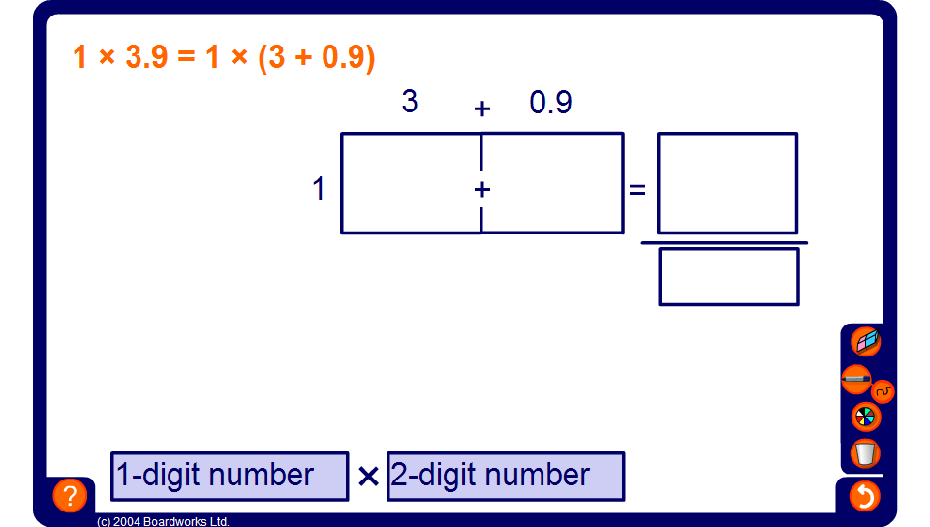


The grid method for multiplying decimals
Notes:
Demonstrate how we can use the grid method to multiply decimals.
If pupils lack confidence in multiplying by decimals, an alternative would be to write an equivalent whole number calculation by multiplying the numbers by 10, 100 and 1000 and dividing by the appropriate amount at the end of the calculation.

